Slide 1

Welcome to CS1101S!
Tutorial Group 03F
Ma Chi Kin Brian
e1121386@u.nus.edu
Tele: @bmanara

Slide 2
Agenda for Today
Introductions
Admin Matters
Expectations
Recap
Modulo Operator
Pre-declared Functions
Source Academy Burger Joint (Studio Worksheet)

Slide 3

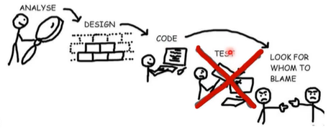
Firstly, congrats on joining NUS CS!
What to expect?
Throughout the semester, you may stumble upon issues…
You can do it!
Feel free to reach out if you are struggling at any point. The CS1101S team is here to help!
Lastly, enjoy your first semester in University!

Slide 4
Hi, I’m Brian!
Current Y2 CS Student (Took CS1101S last year)
Previous School: Anglo Chinese Junior College
I love reading books (currently reading 1984 by George Orwell)
First Time TA!
Why CS?
I kind of enjoy making software and coding
BUT, mostly enjoy the theory behind CS (Algorithm Analysis etc.)

Slide 5
Introduce Yourself!
Name, Local/International Student, previous school, hobbies and the reason behind choosing CS.
Notes:
Give me some time to try and remember your names, Im REALLY BAD AT IT so I apologise if I mispronounce.
Talk about having students having past experiences with coding after introductions
Questions:
Living in campus or off-campus?

Slide 6
Admin Matters
Check Canvas Announcements/Emails etc. frequently
Resources Available
SICP Textbook
Ed, Canvas etc.
Seeking Help
Ed Forums
Tutorial Group Friends
Me
Code of Honor
All work done by you must be your own work (discussions allowed)
NO PLAGIARISM PLEASE!!!
Notes:
Show where the resources are

Slide 7
Admin Matters
Studio XP (500XP max)
Baseline for being present is 200XP
Most will achieve 300 - 350XP for some contribution to discussions
Paths/Missions/Quests XP
Early submissions: +75XP
Submit only when you’re confident you got all correct
Rule of Thumb: 1 unsubmission allowed for each assignment
Goal is to train algorithmic thinking, not trial-and-error
Quests are not compulsory, but if you want to do it, SURE!
Grading Criteria?
Bonus Unit for extra XP?
NO MORE BONUS UNIT (CS1101R)
Most Students will achieve maximum participation before sem ends.
Notes:
Early submission bonus: +75 XP with the usual decay, starting 72 hours from release
Criteria are:
Is the program correct: does it produce the correct results?
Are the names in your program well chosen?
Is the program as simple and understandable as it can be?
Are there comments that explain non-obvious details?
Does the program follow the style guide? (minus one grade and corresponding XP)
In this module, we typically don't worry about the efficiency of your programs, but you need to be aware of the resource consumption of your programs.

Slide 8
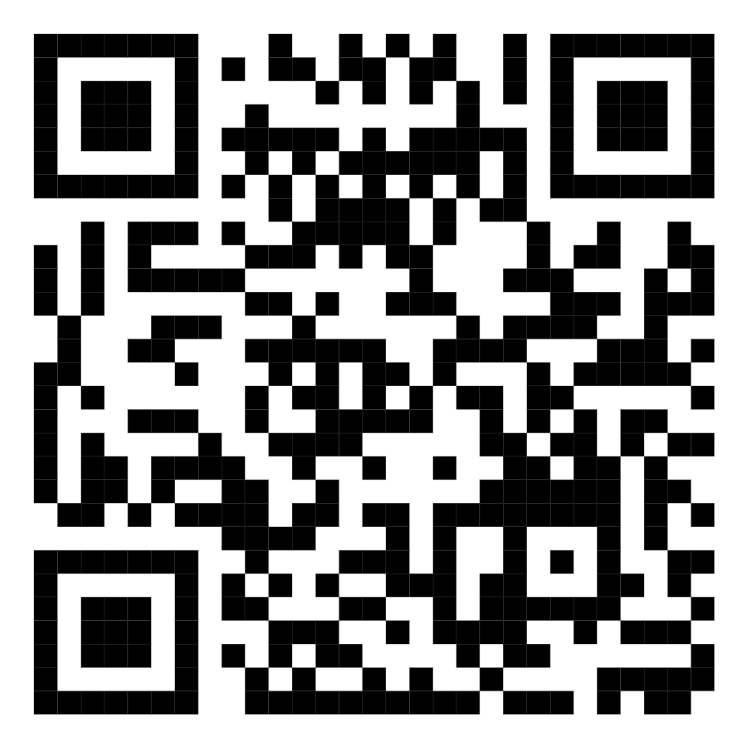
Telegram Group
Main Mode of Communication
within the group
https://t.me/+_v2i6JQJBYwwZjJl

Slide 9
Expectations:
Tutorials:
Come Prepared! (Do the studio worksheet before coming)
Participate and Contribute Actively!
If unable to attend tutorial, message me before the tutorial day. (MCs are valid)
Reaching Out:
Any questions, feel free to msg me and ask! (through tele group preferably)
I may take awhile to respond though… (same day response I promise)
Friends and Ed Forum are faster!
I am not your personal debugger :(

Slide 10
RECAP
Operand Expressions,
Constants,
Compound Functions,
Conditional Expressions & Predicates,
Stepper Tool
Notes:
Go to Source Academy!
Operands (5, 3 etc.) and Operators (+, -, / etc.)
Follows usual math conventions
Prints out “last line”
Our first way to use names to refer to computational objects, CONSTANTS!
We can refer to our constants once declared.
Our first layer of abstraction.
Function declarations, a much more powerful abstraction technique!
With this, a compound operation can be given a name and referred to as a unit.
‘function name(parameters) { return expression; }
name is a symbol associated with the function definition
Parameters are the names used within the body of the function to refer to corresponding arguments.
In the simplest form, the body of a function is a single return statement.
After declaring, we can use it in a function application expression. (calling the function)
‘predicate ? consequent : alternative’
Predicates evaluates to true or false.

Slide 11
Modulo Operator (%)
Pre-declared Functions
Returns remainder that is left over when first operand is divided by the second operand
Eg. 40 % 7 = 5
Some functions are already available for use in Source Academy!
Eg. math_floor, math_ceil…

Slide 12
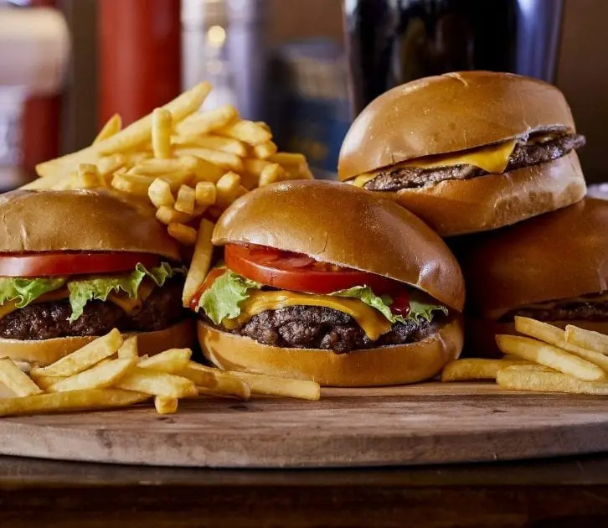
Source Academy Burger Joint
(Studio Worksheet)
Notes:
Go through the first 3 questions, then split them up into pairs and let them do and present their solutions

Slide 13
See you next week!
Slides will be uploaded to the google drive.
Notes:
Get NUSNETID and full name from students

